Slide 1
Customer service - Chatbot
By: Divya Jain

Slide 2
An intelligent Chatbot for the company
Assumptions:
This is having a set goal , thus it’s a business chatbot.
number of requirement fixed before actually developing a chatbot
Conversation for business chatbots are typically short, less than 15mins.
Airline chatbot is providing an information about flights, reservations, delays, webcheckin etc and helps to find the best flight according to user’s criteria and can do bookings accordingly.
the quality of chatbot can be accessed by how many users get to the goal like following:
1. Has the user found the information he/she was looking for?
2. Has the user successfully booked a flight and a hotel?
3. Has the user bought products which help to solve the problem at hand?

Slide 3
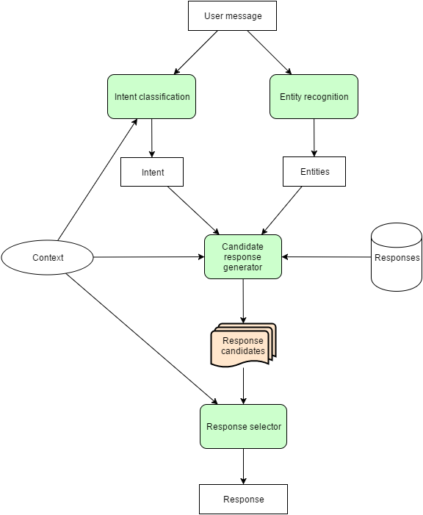
Architecture: Intent Classification Architecture
Why?
For chatbots that deal with multiple domains or multiple services, broader domains, sophisticated, state-of-the-art neural network architectures, such as Long Short-Term Memory (LSTMs) and reinforcement learning agents are the best options.
Machine learning can be applied on intent classification algorithm to classify and find patterns in the natural language, using word embedding. You just need to provide training set of a few hundreds or thousands of examples, and it will pick up patterns in data and classify the intent accurately and in fairly less amount of time.
Retrieval-based models are more practical for this purpose. The chatbot uses the intent and context of conversation for selecting the best response from a predefined list of bot messages.
If a new question or intent appears then the bot developer has to build API for that intent and integrate it . We can also semi-automates this process. The system automatically aggregates and recommend new intents based on user conversations. A human agent can then choose to add it to the bot’s knowledge base or reject it.
New conversational data with new vocabulary is regularly used to retrain the word embedding models on a regular basis. This allows bot to learn continuously. Since this chatbot is based on retival based architecture and not learning on it's own which reduces the risk of bot going crazy to a larger extent.

